Slide 1

Cody Moorhouse
Patryk Kaczmarkiewicz

Slide 2
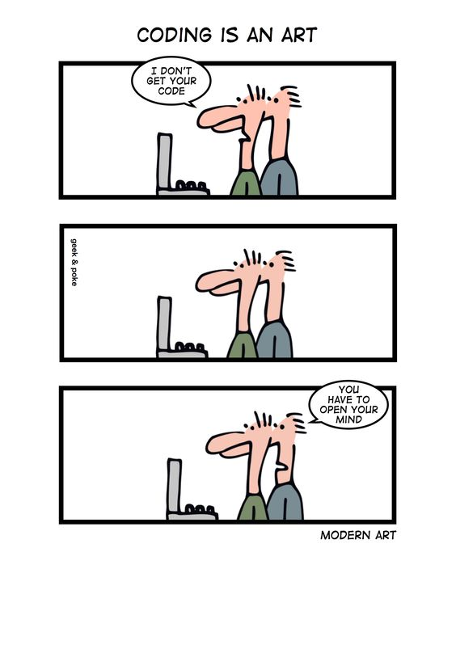
Code

Slide 3


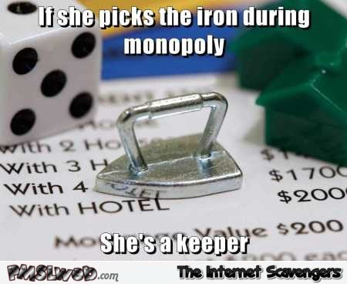
Player.java
No more GUI logic embedded
No more game logic
exchangeProperty (PropertyController)
getOutOfJail (MainController)
getPropertyNumber (removed)
buyProperty (PropertyController)
sellProperty (PropertyController)
canBuyHouse (PropertyController)
263 lines -> 186 lines
Money operators
subtractMoney
addMoney

Slide 4

BoardController.java
No GUI logic
Gained a lot of functions from MainController
Assigns player colors
Meant for doing operations on GameBoard
getCurrentPlayer getCurrentPlayerIndex getGameBoard getPlayer getPlayerIndex | getNewPositionIndex getNumberPlayers getPlayers getTurn movePlayer | reset (extracted partially) setGameBoard setNumberOfPlayers switchTurn

Slide 5

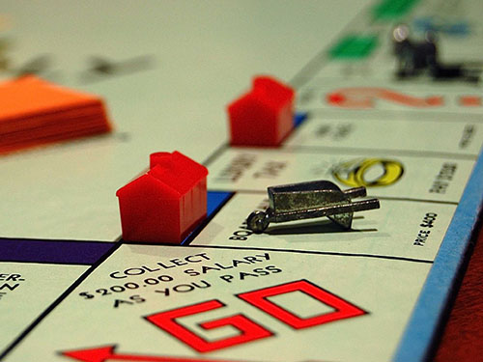
PropertyController.java
Gained a lot of functions from Player Class and GameMaster
getSellerList
purchaseHouse
buyProperty
purchase
getMonopolies
canBuyHouse
giveAllProperties
payRentTo
sellProperty
updatePropertyRent
resetPropertyRent
doublePropertyRent
updateRailRoadRent
Meant for dealing with property operations
SUCKS TO BE YOU
YOU CAME TO THE WRONG NEIGHBORHOOD

Slide 6
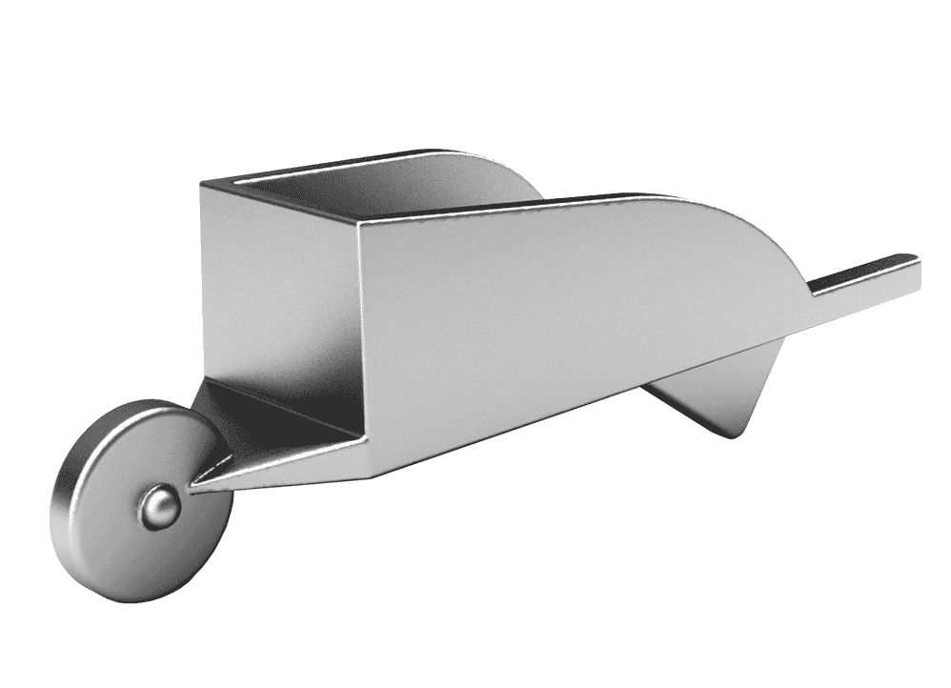
MainController.java
No more .instance() -- Implemented Singleton Pattern
No more testmode
Acts as a middle man (calls other controllers, notice similar function names)
btnBuyHouseClicked btnDrawCardClicked btnEndTurnClicked btnGetOutOfJailClicked btnPurchasePropertyClicked btnRollDiceClicked btnTradeClicked completeTrade drawCCCard | drawChanceCard getCurrentPlayer getGameBoard getGUI getNumberOfPlayers getPlayer getPlayerIndex getSellerList getUtilDiceRoll movePlayer | finishPlayerMove purchase reset sendToJail setAllButtonEnabled setGameBoard setGUI setNumberOfPlayers startGame | switchTurn utilRollDice getTurn getOutOfJail purchaseHouse getMonopolies canBuyHouse giveAllProperties payRentTo getDice
SAYYY WHAAT?!?! (yes Elliott it is possible)

Slide 7
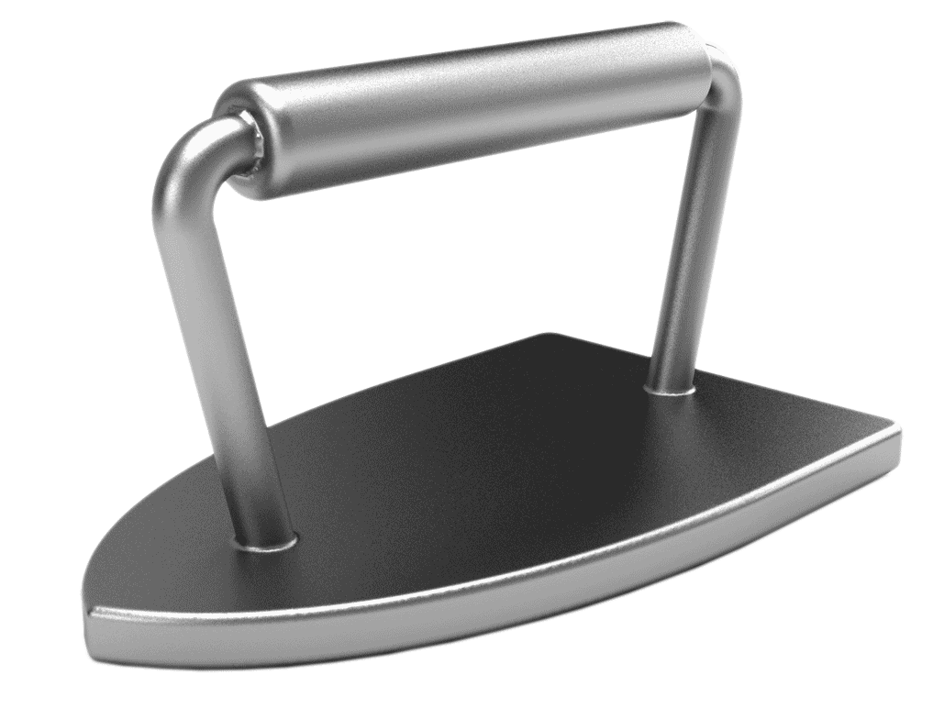

Dice.java
Assignable Dice amount
Functions
Roll
getRoll
getTotal
setDice (used for testing or hacking)
getSingleDice

Slide 8

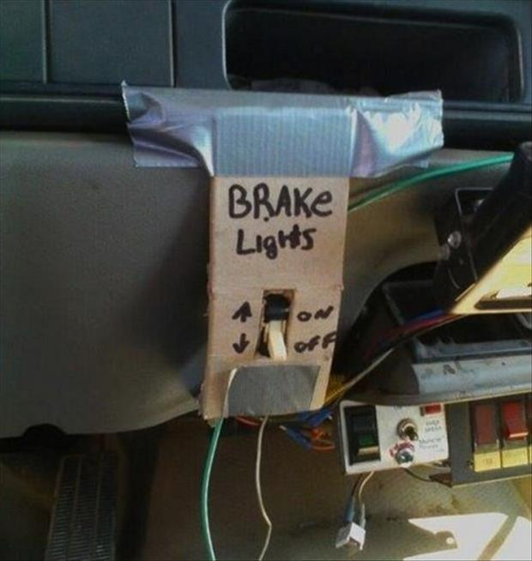
Game Logic Fixes
Buying houses after trading is completed
No more negative trades
Reset rent prices (properties/railroads) after trading
Minimum player requirement
Shuffling

Slide 9

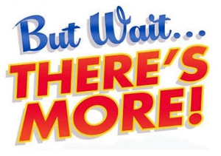



Slide 10

Fixed compiler warnings (SERIAL_UID)
Removed unused classes, methods, variables
Missing @Overrides
Remove deprecated methods (e.g. show, hide)
Fix end-of-game logic
Update constructors (TradeDeal)
Rename variables, classes
Fixing indentation (reformatting)
Remove warnings
Enums -- CardTypes & ColorGroups
Even alphabetized imports
Remove duplicated code
Updating libraries (No raw types)
Removed some magic numbers
Remove commented out code
getLabel -> toString
Remove random print statement
Organize code to alphabetical
Renaming functions, methods, classes
Removed unused imports (including java.util.*)
Remove playAction as interface
Privatization of functions (update access modifiers)

Slide 11

Its peanut butter CODE DEMONSTRATION time

Slide 12
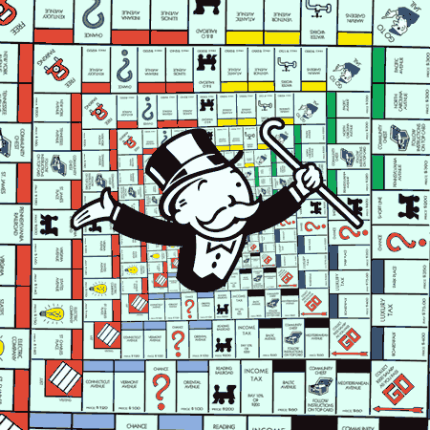
GUI
You will like this, trust us...

Slide 13
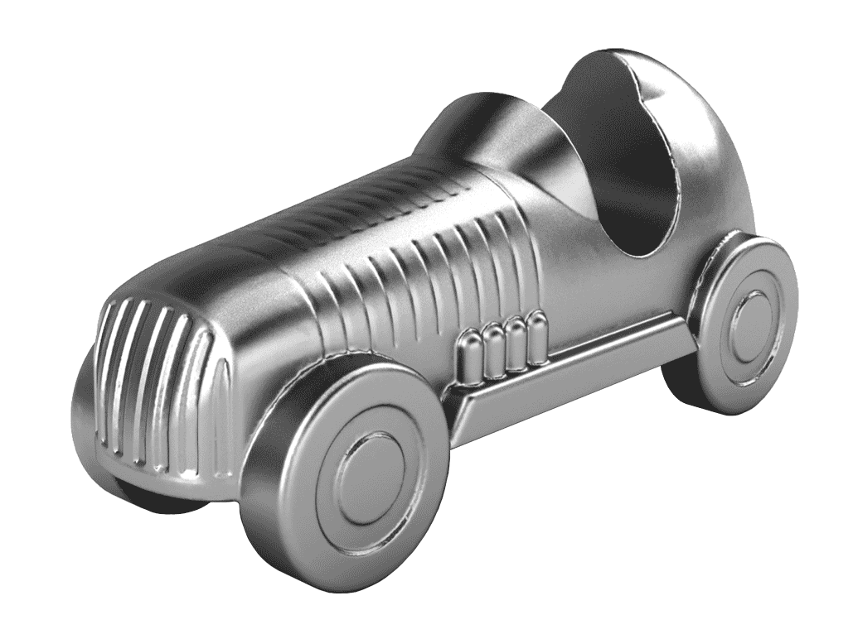
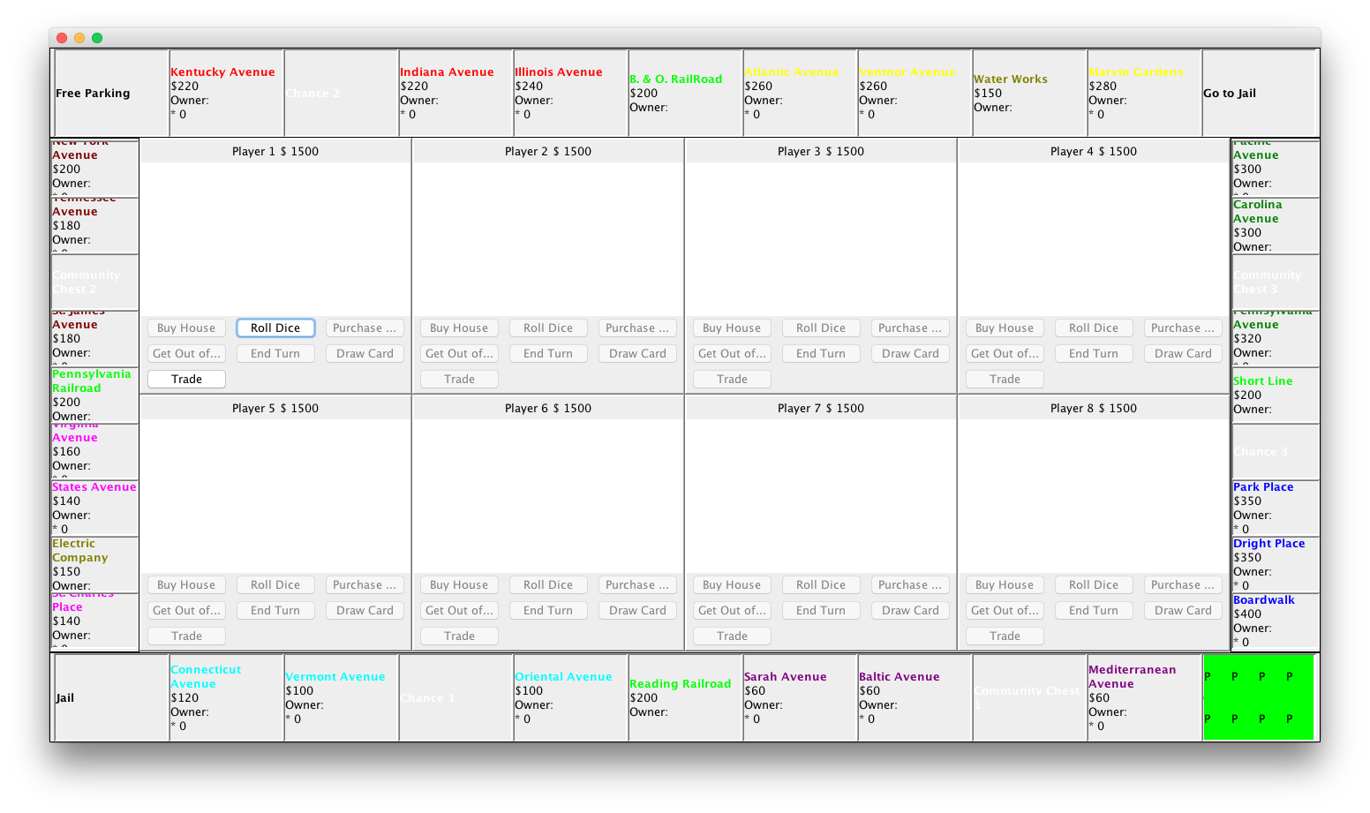
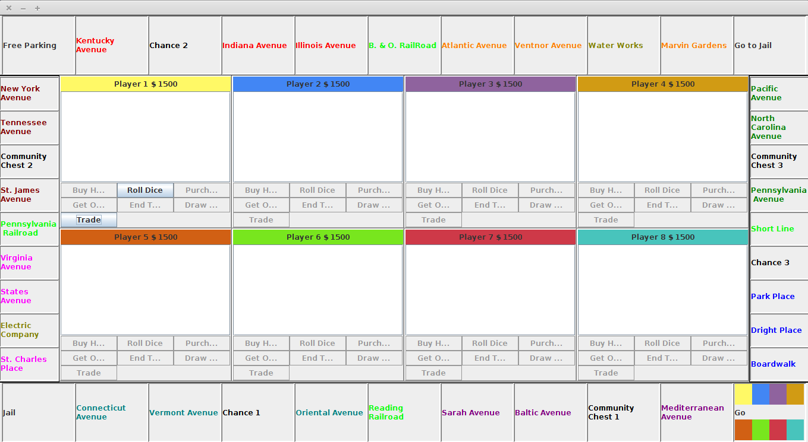
Before
In case you forgot...
After
Don’t worry, we will show you a demo later

Slide 14

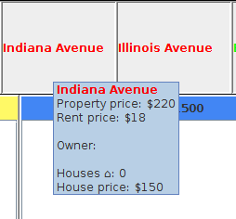
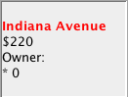
Tooltips
Cleaned up cells
Changed *0 -> Houses
Added prices for rent / houses

Slide 15
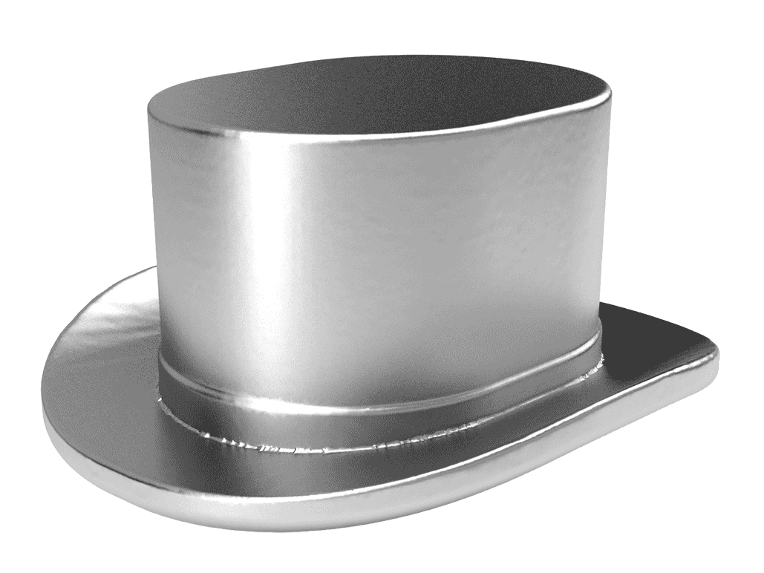
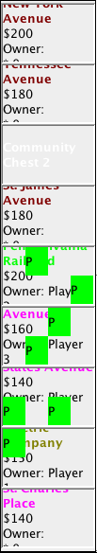
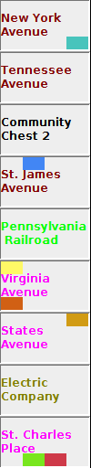
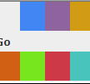
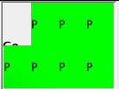
Player Colors
Player pieces don’t cover the whole cell
Added colors to player panels
No more names on player pieces

Slide 16

Dialog Box Positions
Current Player Panel
Rolling dice
Drawing cards
Buying houses
Utility dice roll in current player box
Trade
Trade dialog (starts in player panel, finishes in owner’s player panel)

Slide 17
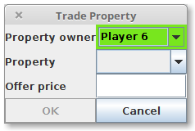
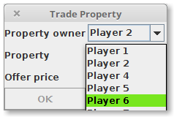
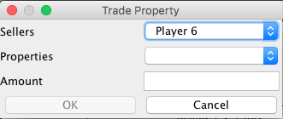
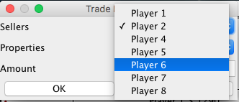
Trade
Its peanut butter CODE DEMONSTRATION time
Player Colors change as you select/hover (real time)
Lets user know if insufficient money
No negative amounts allowed

Slide 18
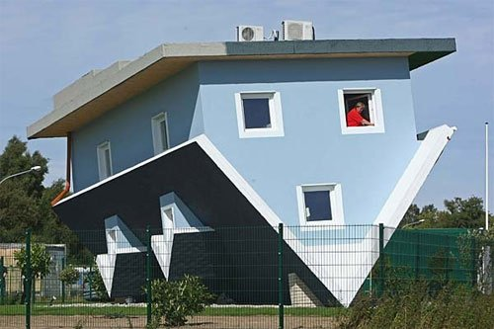

Houses
No longer 6 as an option
Displays maximum houses based on how many are already bought
Remove monopolies from player after trade

Slide 20
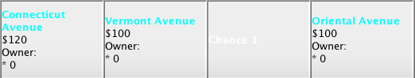
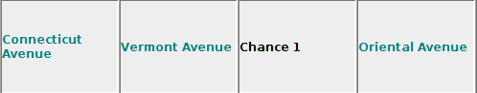
Default names for players
Removed multiple warning boxes (e.g. when starting a game and entering string)
Updated certain cell colors

Slide 21

How does changing the GUI tie in with refactoring?
Spoiler alert: It doesn’t!!
Just Kidding!

Slide 22
Its peanut butter DEMO time

Slide 23
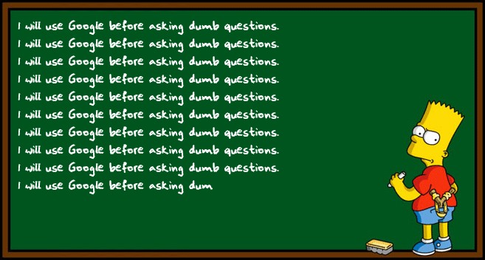
Questions?

